Slide 1
Unit 2: What makes food taste good?
English 1

Slide 2
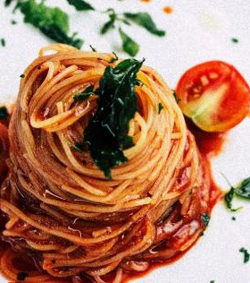
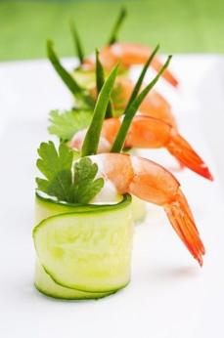
Think & Discuss
What kinds of food do you eat everyday?
What kinds of food do you eat on special occasions?
Look at the pictures. Do you think how food looks; its presentation affects how it tastes? Explain.

Slide 3
Previewing a text
Previewing a text means to get an idea of what we are going to find in a particular text or in other words it is a skill of learning about a text before reading it.
Predict what the text is going to talk about.
Previewing usually includes these steps:
Reading the title & subtitle
Reading the first & last paragraphs
Looking at the photographs and pictures

Slide 4
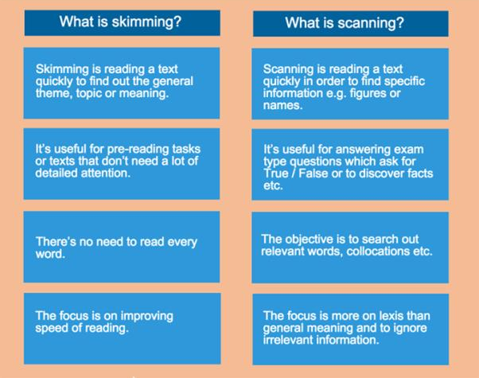
Skimming and Scanning

Slide 5
Use of context to understand words
Understanding Vocabulary in Context.
When readers come across a word they do not know in a text, they use ideas in the sentence (or context clues) to help them make a smart guess about the meaning of the word. Examining the context clues in a sentence or paragraph can help readers understand unfamiliar words.

Slide 6
VOCABULARIES
Balanced
Identity
Likely
Be made up of
Recognize
At risk
Sensitive
System
Typically

Slide 7
Reading & Activity 1
Topic: Knowing your taste, page 32 & 33
Activity B, page 33

Slide 8
Using Descriptive Adjectives in Writing
Adjectives: Words that describe or modify other words, making your writing and speaking much more specific, and a whole lot more interesting.
Descriptive adjectives: Words that describe qualities of a noun or pronoun, such as smell, taste, texture, appearance, and shape.
Quantitative adjective: An adjective that answers the question 'how much' or how many.
Why Use Adjectives?
To be an effective writer or speaker, it is necessary to build sentences that will catch a person's attention regardless of how dull the topic may seem. One way to enhance the appeal of a topic is by including a variety of adjectives.

Slide 9
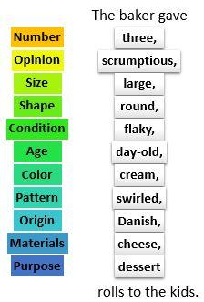
Use & Placement of Adjectives
ORDER OF ADJECTIVES
EXAMPLE
Write a paragraph that describes your favorite dish. Be sure to use adjectives in order to make your description interesting, clear and specific.
4- 5 ines

Slide 10
Practice Part page 49 & 50

Slide 11
Activity
Write a paragraph that describes your favorite dish. Be sure to use adjectives in order to make your description interesting, clear and specific.
Think about your favorite dish, use questions from page 51 to help brainstorm ideas about your topic.

Slide 12
Homework: Reading & Activity 2
Topic: Finding balance in Food, page 38, 39 & 40
Activity B & D, page 40 & 41

Slide 13
THANK YOU

